Slide 1
CLOUD SERVICES
Trade©2024 NETSOL Technologies Inc. All rights reserved. Any unauthorized use or copy of this document is strictly prohibited. [CONFIDENTIAL]

Slide 2
GenAI Use Cases
2 Trade©2024 NETSOL Technologies Inc. All rights reserved. Any unauthorized use or copy of this document is strictly prohibited. [CONFIDENTIAL]

Slide 3
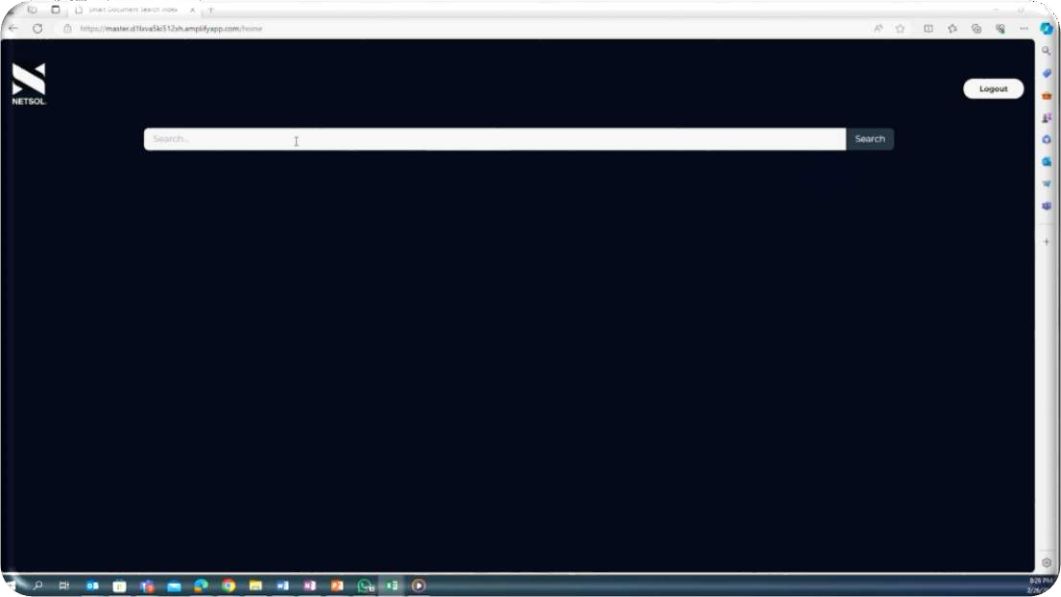
RAG-Enabled AI Search
Industry Vertical: Aviation / Aerospace
Business Opportunity
The customer wanted to explore the potential of GenAI to enable NLP search of airline maintenance manuals allowing technicians to quickly identify the most relevant solutions and troubleshooting steps.
Our Solution
Used AWS Services: Amazon S3, Amazon Bedrock, OpenSearch, AWS Lambda, API Gateway, KMS, and Textract.
We used Bedrock embedding model Titan along with OpenSearch as
vector store to implement RAG.
Implemented a user-friendly frontend UI for secure, efficient natural language-based queries.
Business Outcome
Delivery / Outcome
Enhanced operational efficiency.
Created an efficient, secure, and compliant search system for
technicians to retrieve smart responses.
Better interaction
Boosting Employee Efficiency
Opened doors to new innovations
Optimized
cost

Slide 4
Data Research utilizing Amazon Bedrock
Industry Vertical: Life Sciences
Business Opportunity:
Customer requested a GenAI Proof of Concept (POC) on querying medical and research data. The Solution empowered users to seamlessly retrieve pertinent information from documents through intuitive Natural Language Processing (NLP) queries.
Delivery / Outcome
Our Solution:
Leveraging Amazon Bedrock Knowledge base for efficient document indexing, enhancing search capabilities.
Amazon Bedrock was used for dynamic text generation and intelligent content creation.
Operational Efficiency
Cost and time Increased Productivity
saving
Business Outcome:
Automated search capability with Natural Language.
Reduced time and cost for searching key info.

Slide 5
BI with Amazon QuickSight Q
Industry Vertical: Life Sciences
Business Opportunity
The customer required a GenAI-powered solution for NLP querying of data to gain visualization insights. Data was migrated from on-premises to AWS and NetSol utilized the migrated data to create visualizations.
Delivery / Outcome
Our Solution:
Utilizing Amazon QuickSight Q's latest features to reduce time to meaningful insights with user-friendly self-service.
Developed dynamic dashboards that visually convey insightful results, enhancing data interpretation and decision-making.
Operational efficiency
Real-time data insights
Business Outcome
Data Insights showing real-time results.
Boosted efficiency in key metrics analysis.

Slide 6
Data Points Extraction
Industry Vertical: Life Sciences
Business Opportunity
The customer required automation to extract key data points from a large repository of legal documents.
Our Solution:
Delivery / Outcome
Leverage Amazon Textract to convert legal documents to text.
Utilized Amazon Bedrock to search and extract required data points.
Developed dynamic dashboards to enhance data interpretation.
Business Outcome
Operational efficiency
Real-time data insights
Empowered decision-making through comprehensive insight.
Boosted efficiency in key metrics analysis.

Slide 7
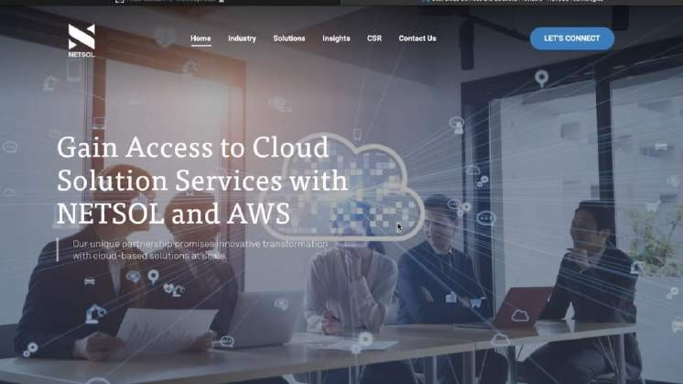
Localized Chatbot
Business Opportunity
Developing a website Chabot solution to increase content localization for an increased customer outreach and engagement.
Our Solution
HTML pages were transformed into text, leveraging an embedding model from Amazon Bedrock service to index the data in an Amazon OpenSearch vector database.
Amazon Bedrock Claude model was used for text generation, enabling advanced capabilities in responding to user queries in different language.
Business Outcome
Improved User Engagement
Increased customer outreach
increased user retention and engagement
Positive customer satisfaction
Potential lead generation
Efficiency and Productivity
Delivery / Outcome
Improved User Engagement
Increased customer outreach
Positive customer satisfaction
Potential lead generation

Slide 8
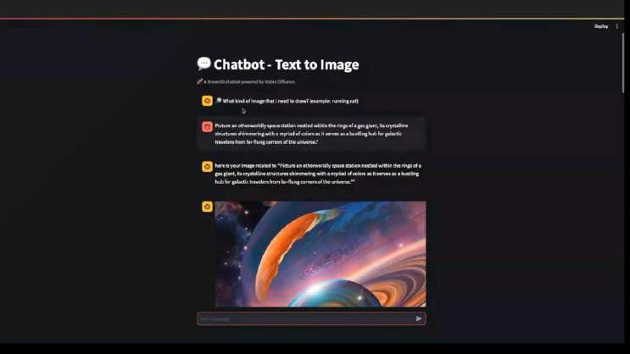
Image Creation with Amazon SageMaker (Stable Diffusion)
Industry Vertical: Digital Media
Business Opportunity
Our solution seamlessly generates captivating images inspired by space odyssey themes using prompts and can be customized for all diverse use cases leveraging enhanced prompts.
Our Solution
Implemented a solution using Amazon SageMaker - Stable diffusion model for image generation.
Deployed the model on SageMaker for inference.
Prompts were shared by users and fed to the model.
Amazon Comprehend was used to ensure positive prompts, optimizing the image generation process.
Enhanced the prompts to generate an image in space Odyssey.
Delivery / Outcome
Business Outcome
Our solution seamlessly generates captivating images using prompts
which can be easily enhanced.
Enabled innovation
Personalized Experience
AI-driven creativity
User-centric

Slide 9
Product Visualization with Stable Diffusion
Business Opportunity
Developing a product visualization solution leveraging AI for enhanced customer engagement, informed decision-making, and increased sales across various industries.
Our Solution
Uses stable diffusion model.
Converts static images into dynamic 3D models.
Enhances visual appeal through intelligent prompts.
Provides businesses with engaging, interactive product showcases.
Delivery / Outcome
Business Outcome
The solution elevates customer engagement and boosts conversion rates by giving the user real-time illustrations of the product.
.
Enhanced Customer Engagement
Improved Customer Understanding
Reduced Product Returns
Increased Conversion Rates

Slide 10
Appendix
10 Trade©2024 NETSOL Technologies Inc. All rights reserved. Any unauthorized use or copy of this document is strictly prohibited. [CONFIDENTIAL]

Slide 11
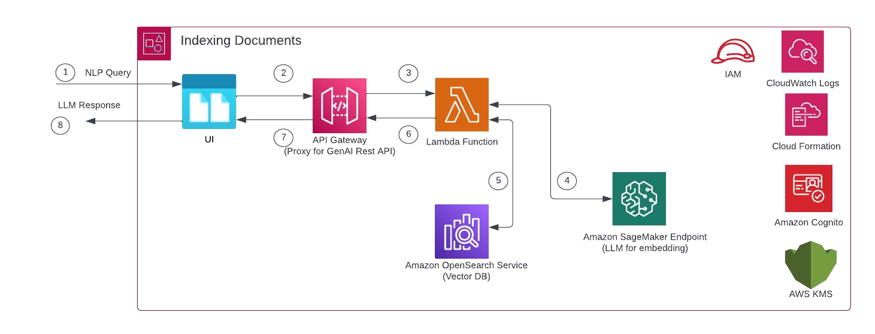
RAG-Enabled AI Search

Slide 12
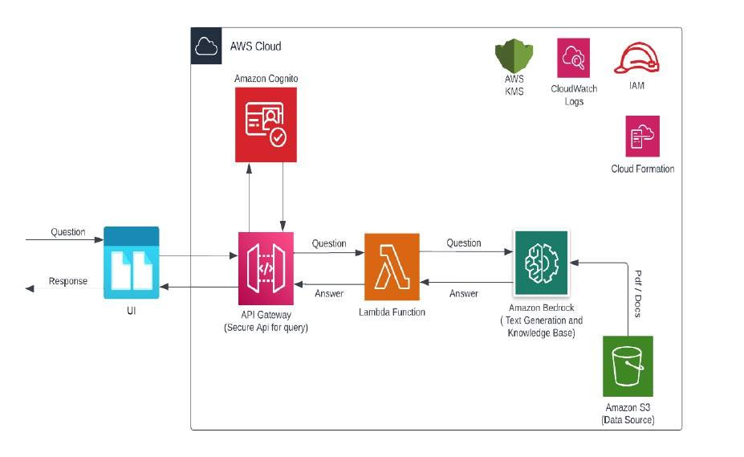
Data Research utilizing Amazon Bedrock

Slide 13
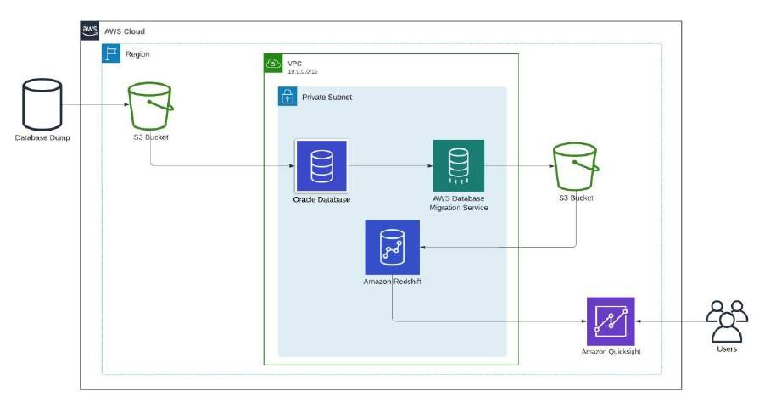
BI with Amazon QuickSight Q

Slide 14
LEADERSHIP TEAM
Furrukh Sohail Head of Cloud Services Ex-NorthBay (AWS Premier Partner) / 25 + years of IT experience | Raj Harjika VP Technology Ex-AWS / 12x AWS Certified / Over 25 years of experience / Published IT Author | Charles Powell VP Sales 20 years of IT Sales Experience with 5 different AWS partners | Dr. Ali Ahmed Head of Scientific Computing 20 years of AI/ML and Data Services Experience

Slide 15
SERVICES AS A SOLUTION
Generative AI / LLM
Data Engineering
App Modernization
DevOps / MLOps
Well Architected Framework
Cloud Migration

Slide 16
SMB MARKET FOCUS
Financial Services Insurance
HealthCare Life Sciences
Travel & Hospitality
16 Trade©2024
NETSOL Technologies Inc. All rights reserved. Any unauthorized use or copy of this document is strictly prohibited. [CO
NFIDENTIAL]

Slide 17
GENAI ADOPTION CHALLENGES
Challenges:
SMBs hesitant to invest in GenAI.
High risk hinders partner investment in SMBs.
Lack of partner funding for GenAI POCs.
How working with NetSol is different?
NetSol validates GenAI's value with SMBs through early POV engagement (e.g.,
Flatirons, Xybion).
NetSol had numerous successful POVs & POCs with SMB customers in 2023.
Netsol will continue to actively support the SMB team to drive customer value and innovation.

Slide 18
SMB Engagement
SOWs priced for SMB customers
Gen AI / ML Workshops
SMB Customer Cloud Adoption
Pre-Sales Support & Spec Req
SA Thought Leadership
POCs

Slide 19
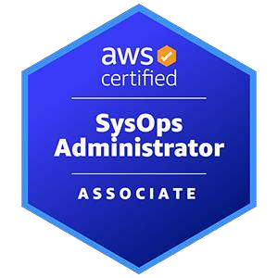
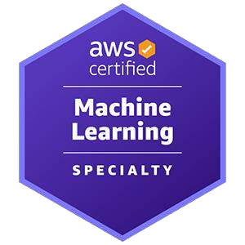
CERTIFICATIONS

Slide 20
THANK YOU
GET IN TOUCH
NETSOL Technologies Inc. (Corporate Headquarters)
816 Congress Avenue, Suite 1270, Austin, Texas 78701
Phone
+1 724 304 9336
E-mail
awscloudservices@netsoltech.com
Website
https://netsolcloudservices.com/
Trade©2024 NETSOL Technologies Inc. All rights reserved. Any unauthorized use or copy of this document is strictly prohibited. [CONFIDENTIAL]

